Slide 1
Deep Residual Learning for Image Recognition
PRESENTED BY Maxwell

Slide 2
Abstract
Deeper neural networks are more difficult to train
ease the training
residual learning framework
substantially deeper network
easier to optimize
Residual networks
gain accuracy
won the 1st place on the ILSVRC 2015 classification task
obtain a 28% relative improvement
Notes:
深层的神经网络学习较为困难，而我们所提出的剩余神经网络可以简化较深的神经网络的训练。
剩余网络可以简化优化，并能得到较高的准确率
我们在各大赛事上都获得了第一名的成绩，同时也在特征检测方面获得了28%的相对提升

Slide 3

Deep Residual Learning for Image Recognition
01
02
03
04
Introduction
Related Work
Deep Residual Learning
Experiments

Slide 4
Introduction
Part One

Slide 5
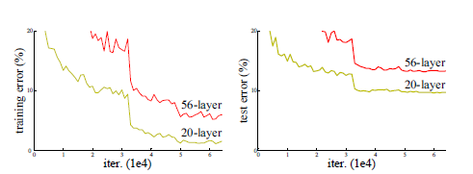
Introduction
network depth is of crucial importance
An obstacle：notorious problem of vanishing/exploding gradients
Network depth increasing
accuracy gets saturated
Notes:
深度对于神经网络训练是一项至关重要的属性，但是目前受限于消失或是爆发增长的梯度，无法一味地增加梯度，因为过于深的网络层级，随着梯度的增加，我们所检测的准确率会主键趋于饱和。

Slide 6
Introduction
Method：
Shallower architecture
its deeper counterpart that adds more layers onto it
Deep model construction:
identity mapping(added layers)
copied from the learned shallower
Model(other layers)
Deeper model should produce no higher training error than its shallower counterpart
Notes:
我们设计这样一种结构：浅层架构+深度的副本
深度的模型结构：被添加的层级是identity mapping，剩余的层级是从浅层复制过来的
这样的架构，可以避免较深层级的错误率高于浅层

Slide 7
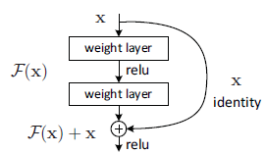
Introduction
Hoping each few stacked layers directly fit a desired underlying mapping
we explicitly let these layers fit a residual mapping.
Denoting the desired underlying mapping as H(x), we let the stacked nonlinear
layers fit another mapping of F(x) := H(x)- x
The formulation of F(x)+x can be realized by feedforward neural networks with “shortcut connections”
Notes:
我们期望堆栈的层级并非要满足我们期望的已有的层级，而是匹配那些剩余层级

Slide 8
Introduction
Shortcut connections are those skipping one or more layers.
Shortcut connections simply perform：
identity mapping
outputs of the stacked layers
“Plain” nets (that simply stack layers) exhibit higher training error when the depth increases
deep residual nets can easily enjoy accuracy gains from greatly increased depth
ImageNet detection
ImageNet localization
win the 1st places on
COCO detection
COCO segmentation
COCO 2015 competitions
Notes:
Shortcut connections 每一次跳跃一到两步

Slide 9
Related Work
Part two

Slide 10
Related Work
Residual Representations
VLAD
image recognition
formulated as a probabilistic version
Fisher Vector
An alternative to Multigrid is hierarchical basis preconditioning, which relies on variables that represent residual vectors between two scales
These methods suggest that a good reformulation or preconditioning can simplify the optimization
Notes:
在图像处理中，VLAD是一种与字典相关的，被剩余向量编码的代表物，而费舍尔向量被论证为VLAD的一个概率版本

Slide 11
Related Work
Shortcut Connections
A few intermediate layers are directly connected to auxiliary classifiers for addressing vanishing/exploding gradients.
When a gated shortcut is “closed” (approaching zero), the layers in highway networks represent non-residual functions.
In addition, high- way networks have not demonstrated accuracy gains with extremely increased depth (e.g., over 100 layers).

Slide 12
Deep Residual Learning
Part three

Slide 13

Deep Residual Learning
Residual Learning
Identity Mapping by Shortcuts
Network Architectures

Slide 14
Deep Residual Learning
Residual Learning
Residual Learning: H(x):
Residual functions: H(x) - x
original function: F(x) + x
Residual functions: F(x) = H(x) - x
If the added layers can be constructed as identity mappings, a deeper model should have training error no greater than its shallower counterpart.
The degradation problem suggests that the solvers might have difficulties in approximating identity mappings by multiple nonlinear layers

Slide 15


Deep Residual Learning
Identity Mapping by Shortcuts
represents the residual mapping to be learned.
a building block defined as:
Output vector
Input vector
F =$W_{2}σ$（$W_{2}$x）, $σ$ is RELU
The operation F + x is performed by a shortcut connection and element-wise addition
We can fairly compare plain/residual networks that simultaneously have the same number of parameters, depth, width, and computational cost

Slide 16

Deep Residual Learning
Identity Mapping by Shortcuts
When x and F are not the same dimensions :
we can perform a linear projection $W_{2}$by the shortcut connections to match the dimensions
is only used when matching dimensions.
Although the above notations are about fully-connected layers for simplicity, they are applicable to convolutional layers

Slide 17
Deep Residual Learning
Network Architectures
plain nets
various plain/residual nets
Residual nets
1. Plain Nets
For the same output feature map size, the layers have the same number of filters
two simple design rules
If the feature map size is halved, the number of filters is doubled
so as to preserve the time complexity per layer
Fewer filters and lower complexity than VGG nets: 3.6 billion FLOPs

Slide 18
Deep Residual Learning
Residual Network
plain network
Residual Network
Residual network
The identity shortcuts can be directly used when the input and output are of the same dimensions
The shortcut still performs identity mapping, with extra zero entries padded for increasing dimensions. This option introduces no extra parameter
When the
Dimensions
increase
The projection shortcut is used to match dimensions.
Notes:
剩余网络由两部分组成：plain network和shortcut connection
在输入与输出的维度相同时，identity shortcuts 是可以被直接使用的
当遇维度增加时，shortcut仍然展示identify 映射，引入不存在的参数

Slide 19

Deep Residual Learning
Implementation
A 224 * 224 crop is randomly sampled from an image or its horizontal flip, with the per-pixel mean subtracted.
We adopt batch normalization (BN) right after each convolution and before activation.
We initialize the weights as in and train all plain/residual nets from scratch.
SGD with a mini-batch size of 256
learning rate starts from 0.1,and is divided by 10 when the error plateaus
Attributes
trained for up to 60* ${10}^{4 }$iterations
weight decay of 0.0001
momentum of 0.9
do not use dropout
Notes:
x

Slide 20
Experiments
Part four

Slide 21
Experiments
ImageNet Classification
CIFAR10 and Analysis
Object Detection on
PASCAL and MS COCO

Slide 22
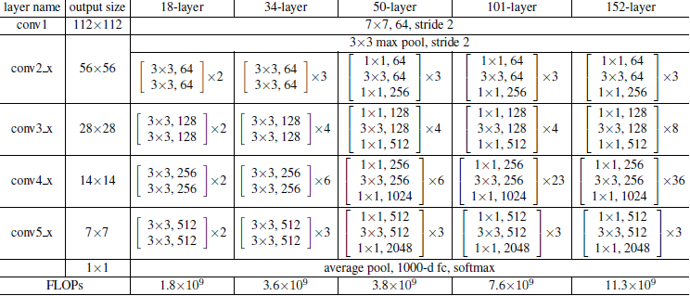
Experiments
Notes:
实验的网络架构图，这里主要对于18层与34层的网络进行比较

Slide 23
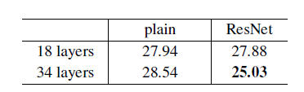
Experiments
4.1. ImageNet Classification
4.1.1 Plain Networks
18-layer
Plain Networks
34-layer
trained with BN
Error rate
forward propagated signals
backward propagated
We conjecture that the deep plain nets may have exponentially low convergence rates, which impact the reducing of the training error.
Notes:
实验的第一部分是plain network,分别构造了18层以及34层的网络，用批量标准化进行处理，分别提供前馈和反向传播
根据我们的判断，深度的plain net存在着根据指数下降的收敛率，从而使得训练的错误有所下降

Slide 24
Experiments
4.1. ImageNet Classification
4.1.2 Residual Networks
18-layer
Residual Networks
34-layer
Identity mapping
Error rate
a shortcut connection is added to each pair of 3*3 filters
Notes:
第二部分：剩余网络，使用了identify映射，并且在3*3的滤波器上添加了shortcut connection

Slide 25
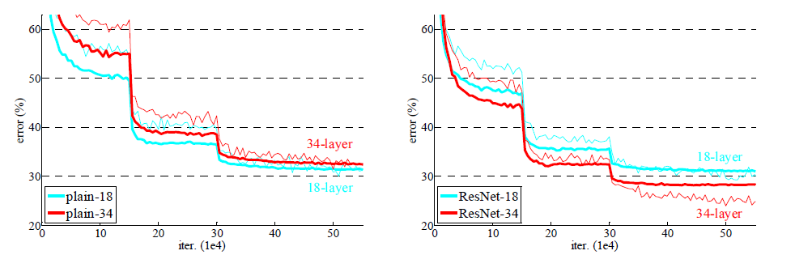
Experiments
4.1. ImageNet Classification
Plain Networks
residual Networks
Notes:
两种网络的训练情况对比

Slide 26
Experiments
4.1. ImageNet Classification
4.1.2 Residual Networks
First, the situation is reversed with residual learning – the 34-layer ResNet is better than the 18-layer ResNet (by 2.8%).
Second, compared to its plain counterpart, the 34-layer ResNet reduces the top-1 error by 3.5% (Table 2), resulting from the successfully reduced training error .
major
observations
Last, we also note that the 18-layer plain/residual nets are comparably accurate , but the 18-layer ResNet converges faster
Notes:
从两种网络的对比情况中我们可以得出三个结论：
1.深度较深的网络的错误率，在剩余网络中体现的更低
2.与plain network 比较，剩余网络34层的错误率更低
3.虽然plain network与residual network在18层网络中体现的错误率类似，但ResNet更加快速

Slide 27
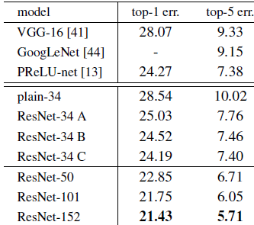
Experiments
4.1. ImageNet Classification
4.1.3 Identity vs. Projection Shortcuts
Zero-padding shortcuts are used for increasing dimensions, and all shortcuts are parameter-free
Projection shortcuts are used for increasing dimensions, and other shortcuts are identity
All shortcuts are projections
to reduce memory/ time complexity and model sizes
Notes:
这里引入Projection Shortcuts的概念（维度升降时使用）
A:零填充的shortcut，用于维度的增加，且不需要参数
B:Projection Shortcuts用于维度增加，其他的是identity shortcut
C:所有的shortcut都为projection shortcut,这里为了减少存储以和计算的复杂度，我们不使用这种case

Slide 28
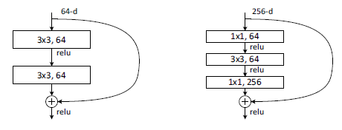
Experiments
4.1. ImageNet Classification
4.1.3 Deeper Bottleneck Architectures
For each residual function F, we use a stack of 3 layers instead of 2 (Fig. 5). The three layers
are 1*1, 3*3, and 1*1 convolutions,
Left: a building block (on 56*56 feature maps）for ResNet-34.
Right: a “bottleneck” building block for ResNet-50/101/152.
Notes:
深度bottleneck 结构

Slide 29
Experiments
4.1. ImageNet Classification
4.1.3 Deeper Bottleneck Architectures
If the identity shortcut in Fig. 5 (right) is replaced with projection, one can show that the time complexity and model size are doubled, as the shortcut is connected to the two high-dimensional ends. So identity shortcuts lead to more efficient models for the bottleneck designs.
Notes:
图中显示：如果identify shortcut 被projection 所代替，则时间复杂度及模型大小会翻倍，并且shortcut会连接到两个高维度端，所以identity shortcut会提升模型的效率

Slide 30
Experiments
4.1. ImageNet Classification
4.1.4 50-layer ResNet:
50-layer ResNet: We replace each 2-layer block in the 34-layer net with this 3-layer bottleneck block, resulting in a 50-layer ResNet. This model has 3.8 billion FLOPs.
4.1.5 101-layer and 152-layer ResNets:
We construct 101- layer and 152-layer ResNets by using more 3-layer blocks. the 152-layer ResNet (11.3 billion FLOPs) still has lower complexity than VGG-16/19 nets (15.3/19.6 billion FLOPs). It is are more accurate than the 34-layer ones by considerable margins
Notes:
这里又构建了50层和101层的网络，实验结果显示他们的时间复杂度都较低，并随着深度的增加，准确率不断地提升

Slide 31

Experiments
4.2. CIFAR10 and Analysis
We conducted more studies on the CIFAR-10 dataset, which consists of 50k training images and 10k testing images in 10 classes.
First layer : 3*3 convolutions
Stack of 6n layers with 3*3 convolutions on the feature maps of sizes {32; 16; 8} respectively
The subsampling is performed by convolutions with a stride of 2.
Ends with a global average pooling, a 10-way fully-connected layer
Softmax.
Notes:
Cifar-10测试的网络架构

Slide 32
Experiments
4.2.1 CIFAR10 and Analysis
We conducted more studies on the CIFAR-10 dataset, which consists of 50k training images and 10k testing images in 10 classes.
weight decay of 0.0001
momentum of 0.9
adopt the weight initialization and BN
Cifar-10
experiment
with no dropout.
trained with a minibatch size of 128 on two GPUs
start with a learning rate of 0.1
divide it by 10 at 32k and 48k iterations, and terminate training at 64k iterations
Notes:
Cifar-10测试的网络架构

Slide 33
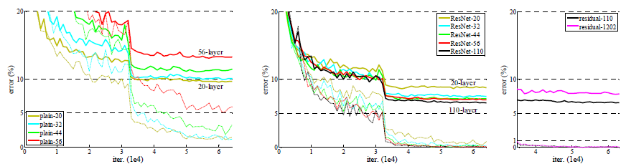
Experiments
4.2.1 CIFAR10 and Analysis
Plain networks. The error
of plain-110 is higher than 60% and not displayed
ResNets.
ResNets with 110 and 1202 layers.

Slide 34
Experiments
4.2.2 Analysis of Layer Responses
Fig. 7 shows the standard deviations (std) of the layer responses. The responses are the outputs of each 3*3 layer, after BN and before other nonlinearity (ReLU/addition).
For ResNets, this analysis reveals the response strength of the residual functions.
Fig. 7 shows that ResNets have generally smaller responses than their plain counterparts.
These results support our basic motivation (Sec.3.1) that the residual functions might
be generally closer to zero than the non-residual functions.

Slide 35
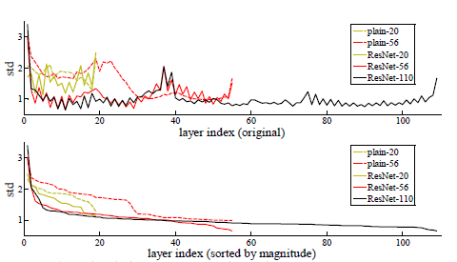
Experiments
4.2.2 Analysis of Layer Responses
the layers are shown in their original order
the responses are ranked in descending order.

Slide 36
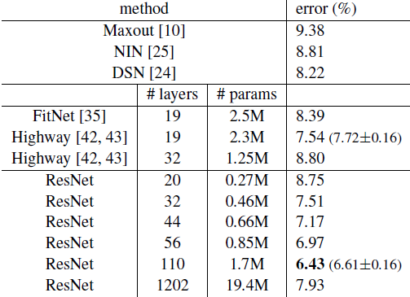
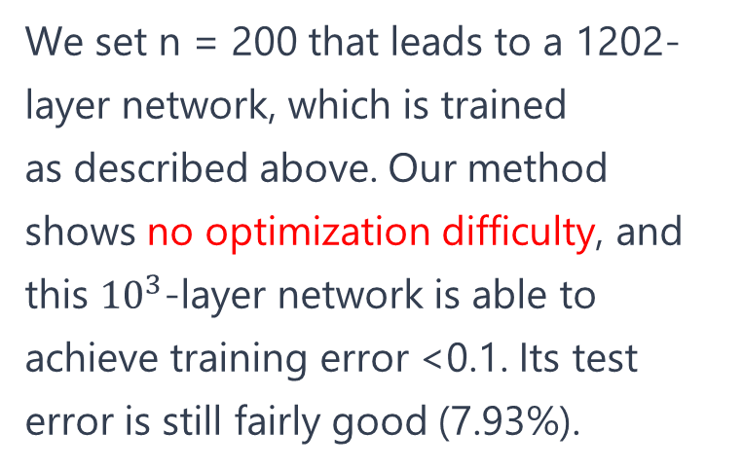
Experiments
4.2.3 Exploring Over 1000 layers.
We set n = 200 that leads to a 1202-layer network, which is trained
as described above. Our method shows no optimization difficulty, and this ${10}^{3}$-layer network is able to achieve training error <0.1. Its test error is still fairly good (7.93%).

Slide 37
Experiments
4.2.3 Exploring Over 1000 layers.
But there are still open problems on such aggressively deep models. The testing result of this 1202-layer network is worse than that of our 110-layer network, although both have similar training error. We argue that this is because of overfitting.
The 1202-layer network may be unnecessarily large (19.4M) for this small dataset
In this paper, we use no maxout/dropout and just simply impose regularization via deep and thin architectures by design, without distracting from the focus on the difficulties of optimization.

Slide 38
Experiments
4.3. Object Detection on PASCAL and MS COCO
Our method has good generalization performance on other recognition tasks.
We adopt Faster R-CNN as the detection method. Here we are interested in the improvements
of replacing VGG-16 with ResNet-101.
The detection implementation of using both models is the same, so the gains can only be attributed to better networks.
Based on deep residual nets, we won the 1st places in several tracks in ILSVRC & COCO 2015 competitions: ImageNet detection, ImageNet localization, COCO detection, and COCO segmentation

Slide 39

OfficePLUS
背景图片素材

